Slide 1


GivingLottery: Welcome Pack for Causes
A quick, watchable guide to setting up and growing your Cause Lottery.

Slide 2
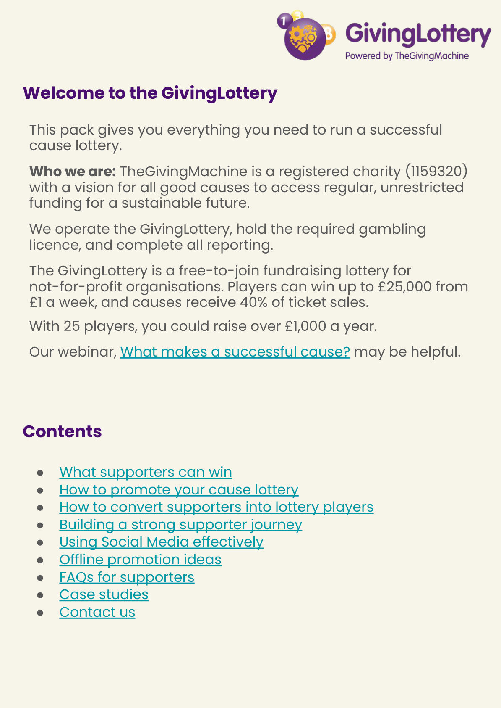
Welcome: what this pack covers
Who we are (TheGivingMachine charity) and what GivingLottery is
What supporters can win
How to promote, convert supporters, and build a strong journey
Social media + offline promotion ideas
Supporter FAQs and two case studies
How to contact us
Notes:
Based on the contents list and introduction in the Welcome Pack (page 2).

Slide 3
Who we are & what GivingLottery is
TheGivingMachine is a registered charity (1159320) with a vision for all good causes to access regular, unrestricted funding.
We operate the GivingLottery, hold the required gambling licence, and complete all reporting.
GivingLottery is free to join for not‑for‑profit organisations.
Players can win up to £25,000 from £1 a week, and causes receive 40% of ticket sales.
With 25 players, you could raise over £1,000 a year.
Notes:
Key points from page 2 of the Welcome Pack.

Slide 4
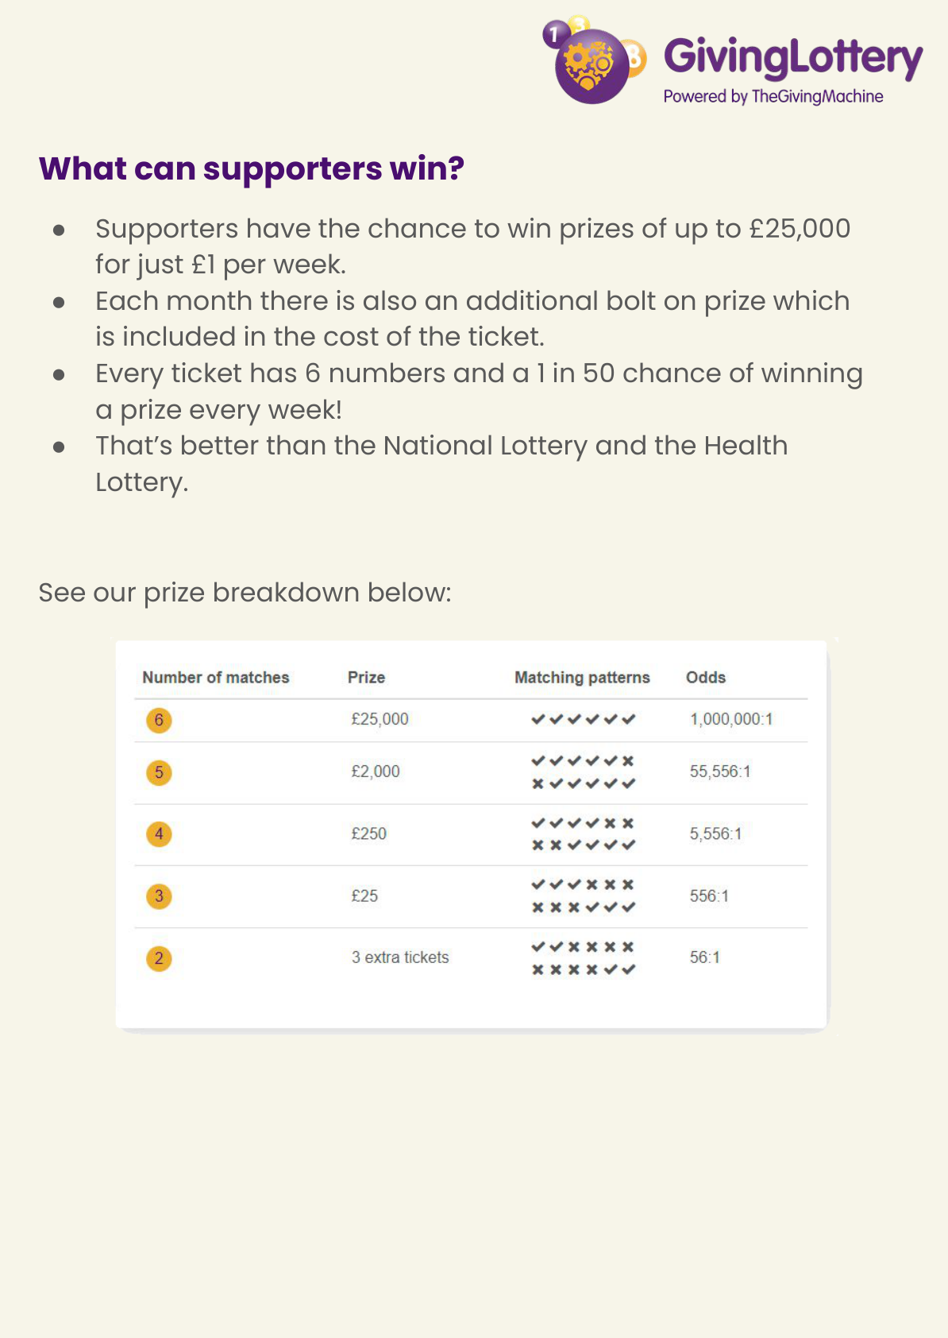
What supporters can win
Cash prizes of up to £25,000 for £1 per week.
Each month includes an additional bolt‑on prize (included in ticket cost).
Every ticket has 6 numbers and a 1 in 50 chance of winning a prize every week.
Odds are better than the National Lottery and the Health Lottery.
Notes:
Slide summarises page 3; image includes the prize breakdown table.

Slide 5
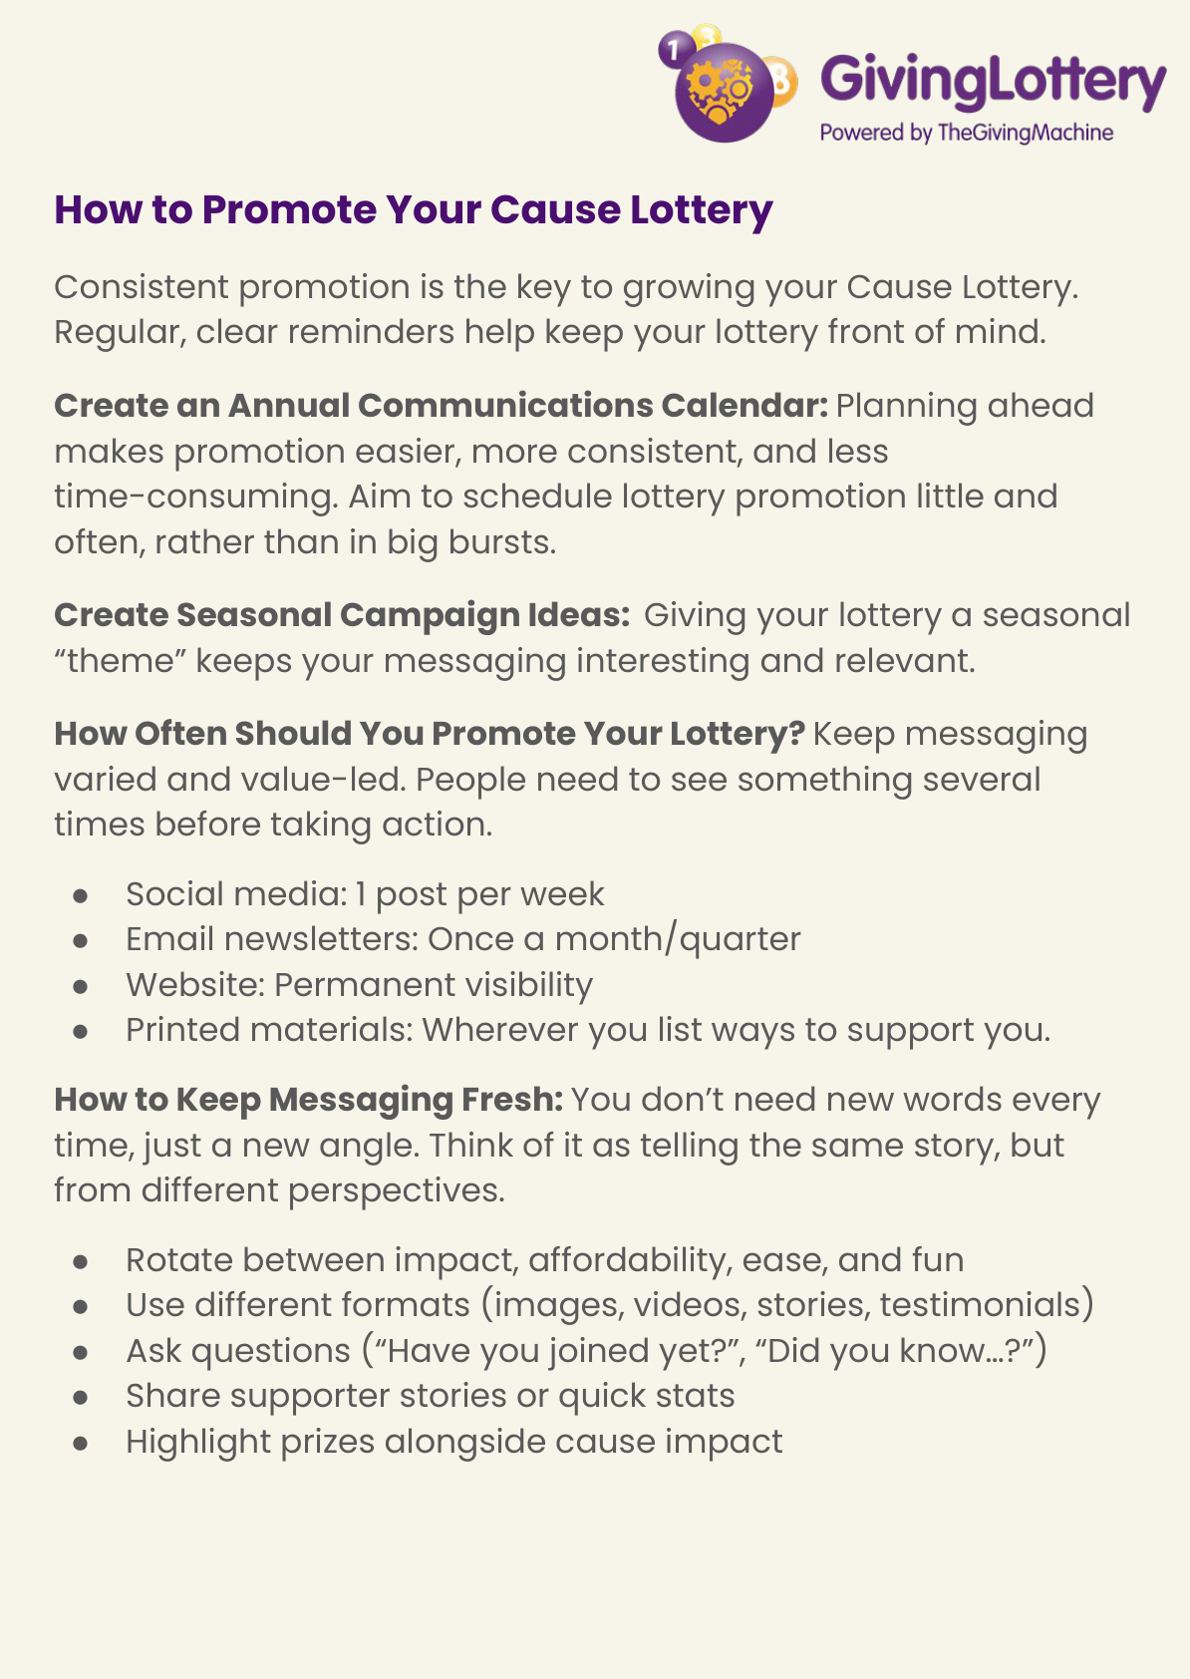
Promotion: the big idea
Consistent promotion is key—regular, clear reminders keep the lottery front of mind.
Plan ahead with an annual communications calendar.
Create seasonal themes to keep messaging relevant.
Promote little and often, not in big bursts.
How often to promote (suggested rhythm)
Social media: 1 post per week
Email newsletters: once a month / quarter
Website: permanent visibility
Printed materials: wherever you list ways to support you
Notes:
Based on page 4.

Slide 6
Keep messaging fresh
Same story, different angles-rotate between impact, affordability, ease, and fun.
Mix formats: images, videos, stories, testimonials.
Ask questions ("Have you joined yet?", "Did you know…?")
Share supporter stories or quick stats.
Highlight prizes alongside cause impact.
Ready-to-use copy (examples)
Short social reminder: support us for £1/week + link
Impact-led message: one small weekly entry = long-term support
Newsletter snippet: support us all year round + weekly prizes
Seasonal reminder: simple way to support this season/event
Tip: Consistency beats creativity - keep showing up
Notes:
Messaging angles from page 4.

Slide 7
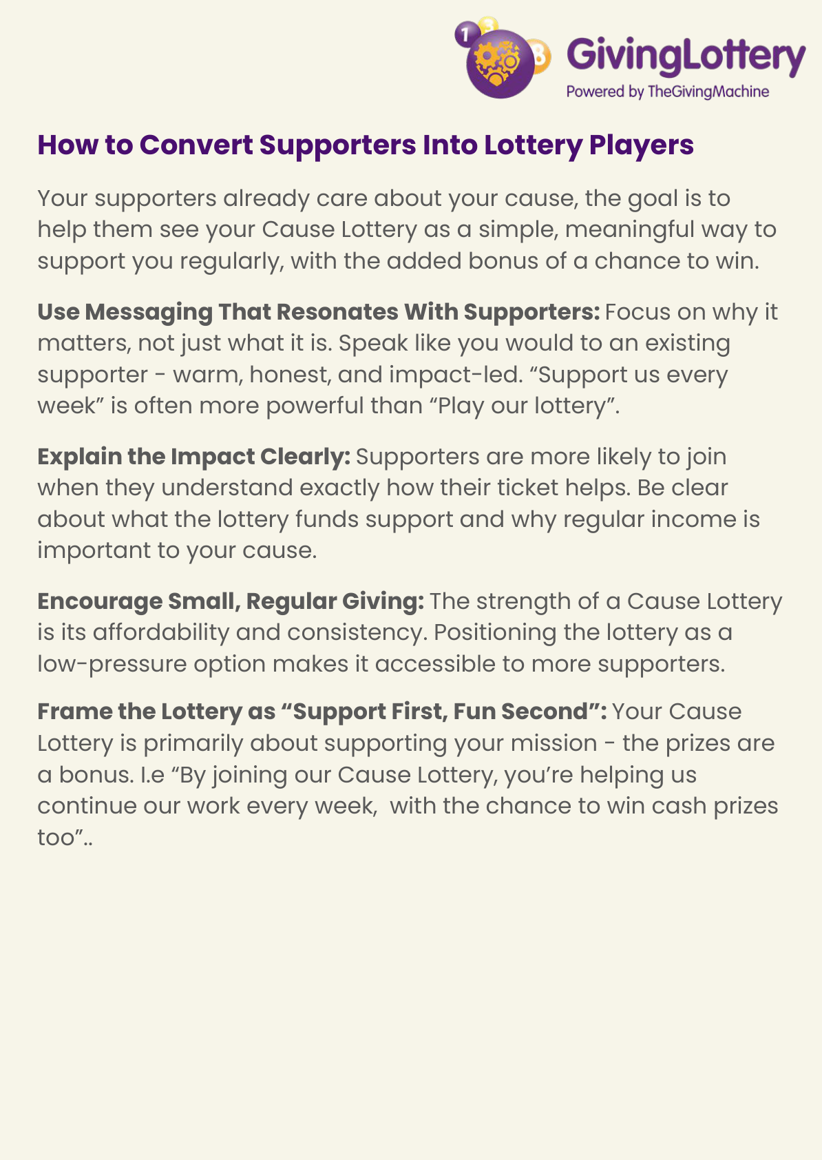
Convert supporters into players: how to frame it
Your supporters already care, help them see the lottery as a simple, meaningful way to support you regularly.
Use warm, honest, impact-led language: “Support us every week” can land better than “Play our lottery”.
Explain impact clearly: what the lottery funds and why regular income matters.
Encourage small, regular giving - affordable and consistent.
Support first, fun second - prizes are the bonus.
Notes:
Based on page 6.

Slide 8
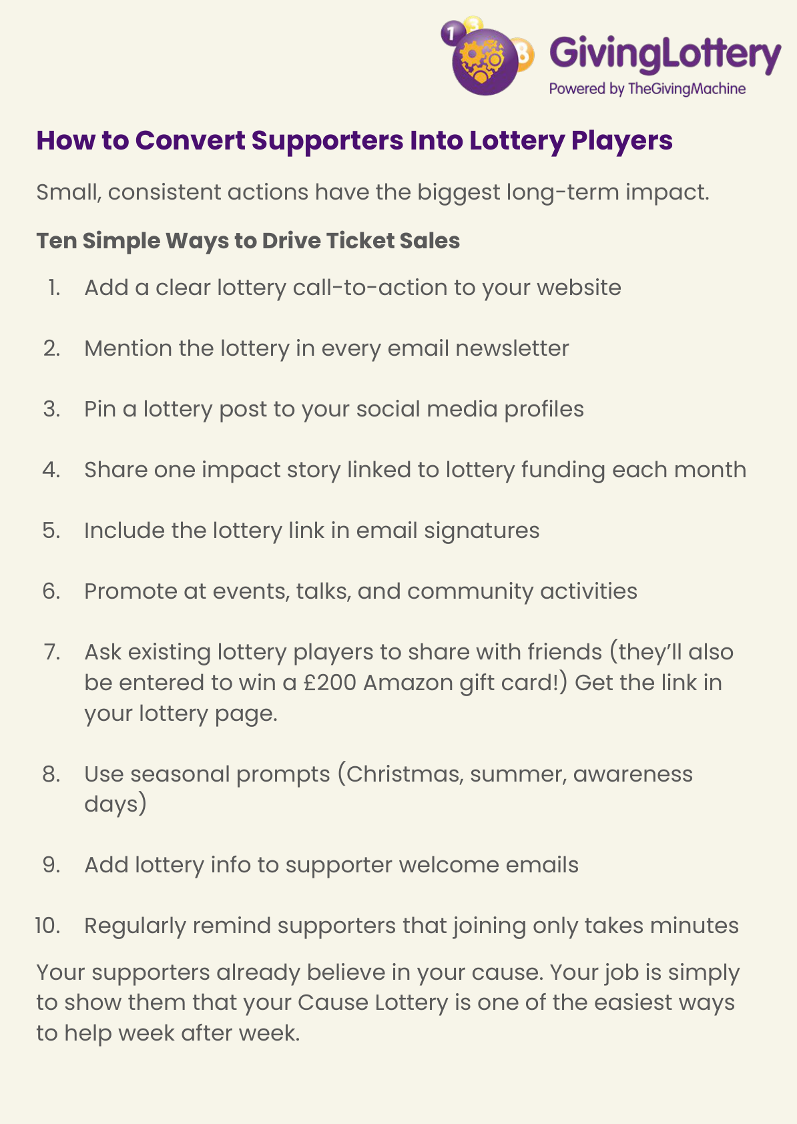
10 simple ways to drive ticket sales
Add a clear call-to-action on your website
Mention the lottery in every email newsletter
Pin a lottery post to your social profiles
Share one impact story linked to lottery funding each month
Include the lottery link in email signatures
Promote at events, talks, community activities
Ask existing players to share (incentive: £200 Amazon gift card entry)
Use seasonal prompts (Christmas, summer, awareness days)
Add lottery info to supporter welcome emails
Remind supporters it only takes minutes to join
Notes:
List from page 7; includes the refer-a-friend incentive mentioned there.

Slide 9
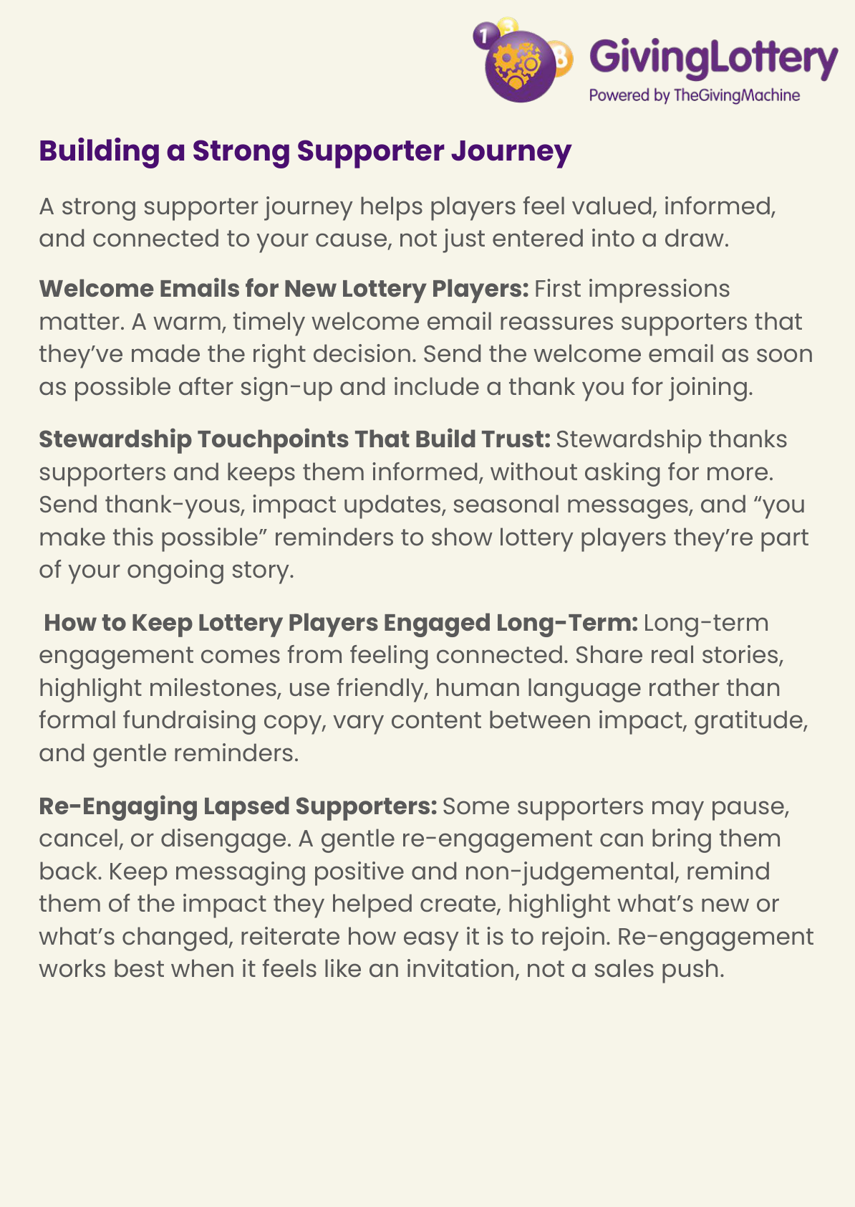
Build a strong supporter journey
Welcome new lottery players quickly with a warm thank-you email.
Add stewardship touchpoints that build trust: thank-yous, impact updates, seasonal messages.
Keep engagement long-term by sharing real stories and milestones in friendly, human language.
Re-engage lapsed supporters with positive, non‑judgemental invitations: remind them of impact, share what’s new, and make rejoining easy.
Notes:
Based on page 8.

Slide 10
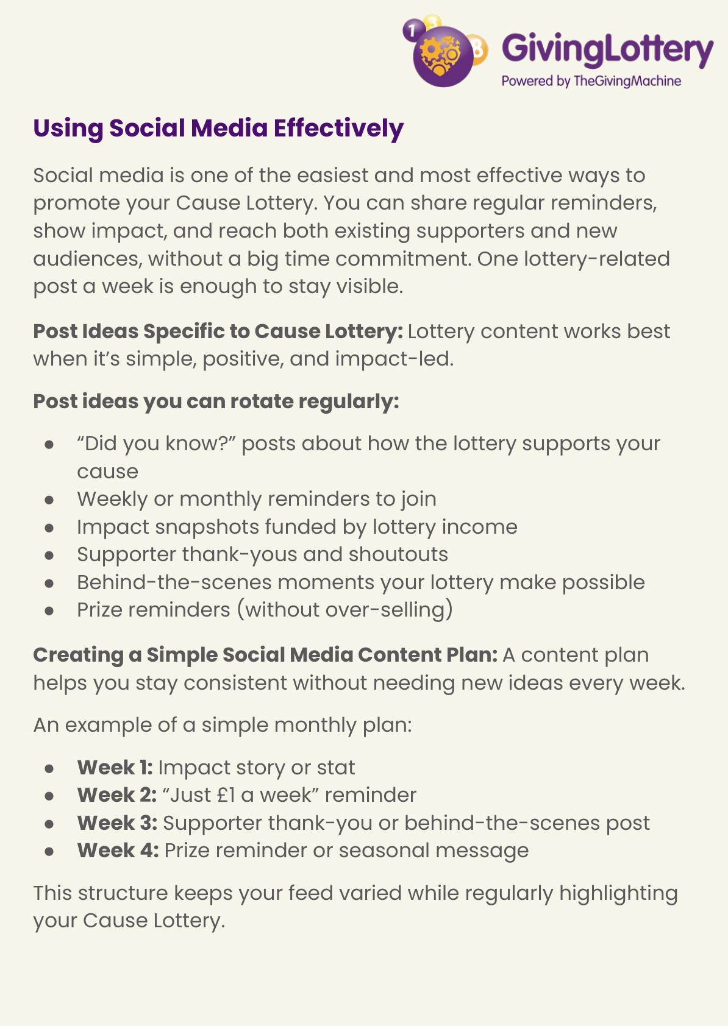
Social media: simple + effective
One lottery-related post a week is enough to stay visible.
Keep posts simple, positive, and impact-led.
Rotate: “Did you know?” facts, reminders, impact snapshots, thank-yous, behind-the-scenes, prize reminders (without over-selling).
A simple monthly content plan
Week 1: Impact story or stat
Week 2: “Just £1 a week” reminder
Week 3: Supporter thank-you or behind-the-scenes
Week 4: Prize reminder or seasonal message
Notes:
Based on page 9.

Slide 11
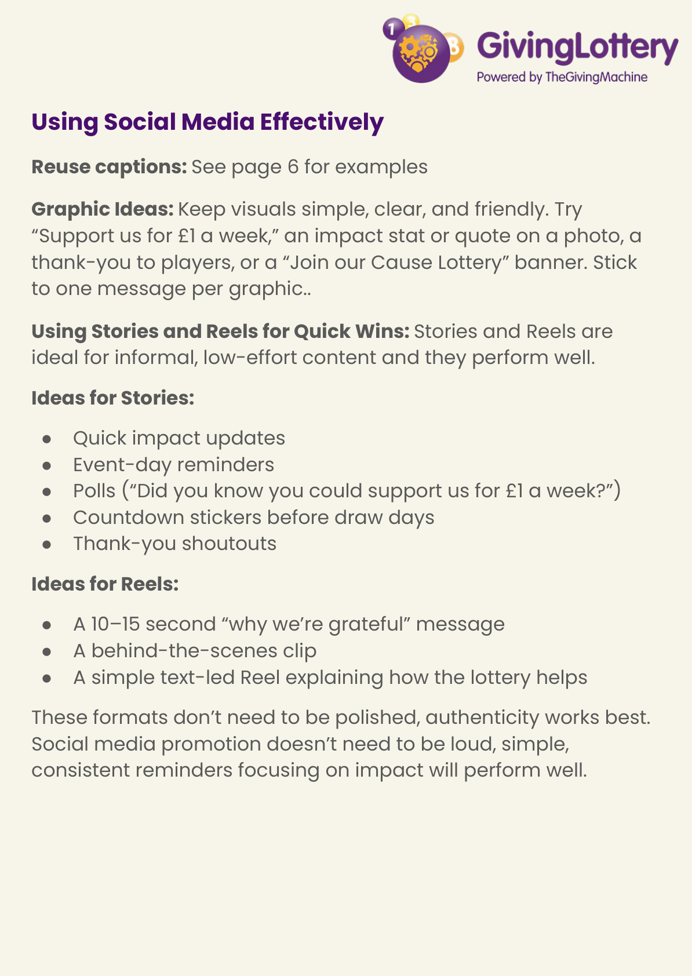
Stories & Reels: quick wins
Stories ideas: quick impact updates, event-day reminders, polls, countdowns, thank-you shoutouts.
Reels ideas: 10-15s gratitude message, behind-the-scenes clip, text-led explainer of how the lottery helps.
Authenticity works best - doesn’t need to be polished.
Notes:
Based on page 10.

Slide 12
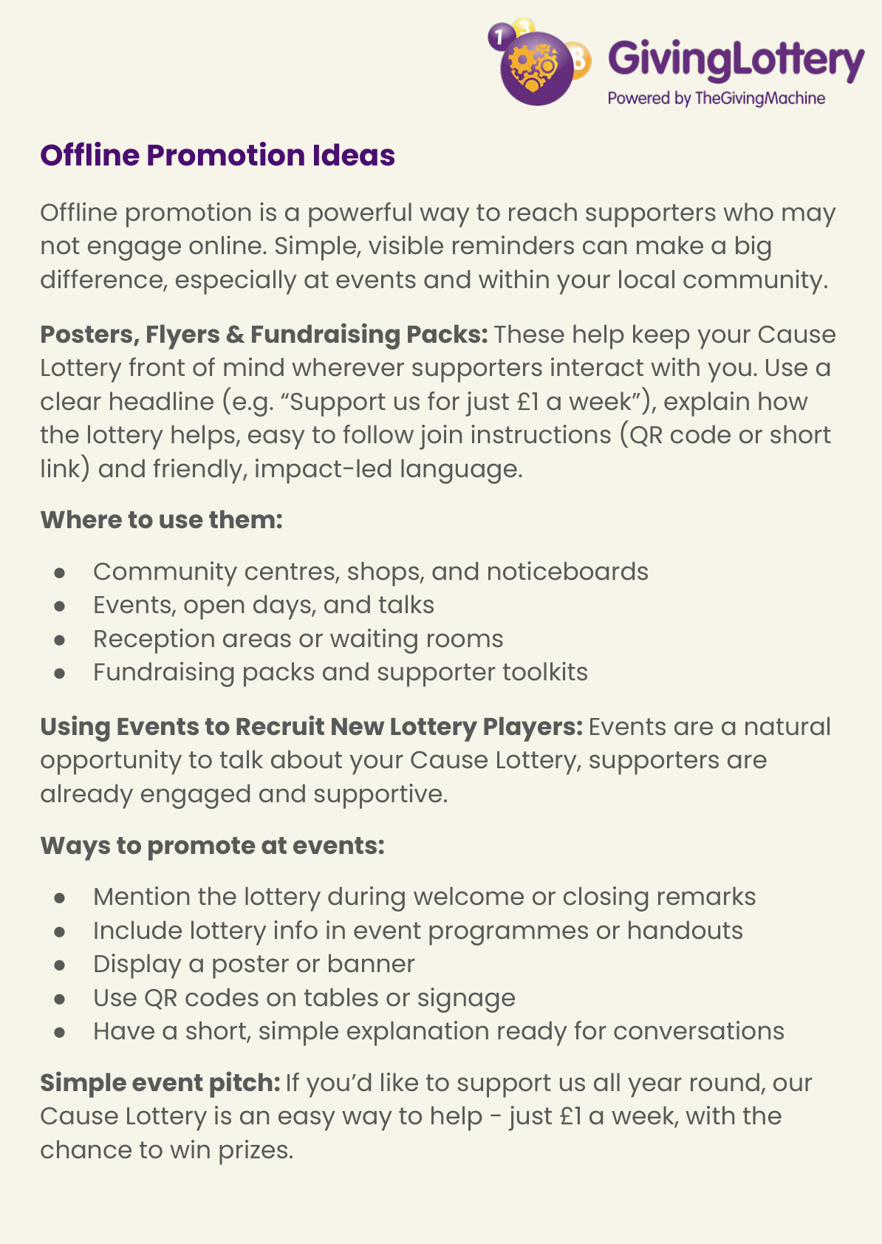
Offline promotion ideas
Use posters/flyers/fundraising packs with a clear headline (e.g., “Support us for just £1 a week”).
Explain how the lottery helps + simple join instructions (QR code/short link).
Place materials where supporters already are: community centres, shops, events, reception areas, packs/toolkits.
Events: your simple pitch
Mention the lottery in welcome/closing remarks.
Include lottery info in programmes or handouts.
Display a poster or banner; use QR codes on tables/signage.
Have a short, friendly explanation ready.
Notes:
Based on page 11.

Slide 13
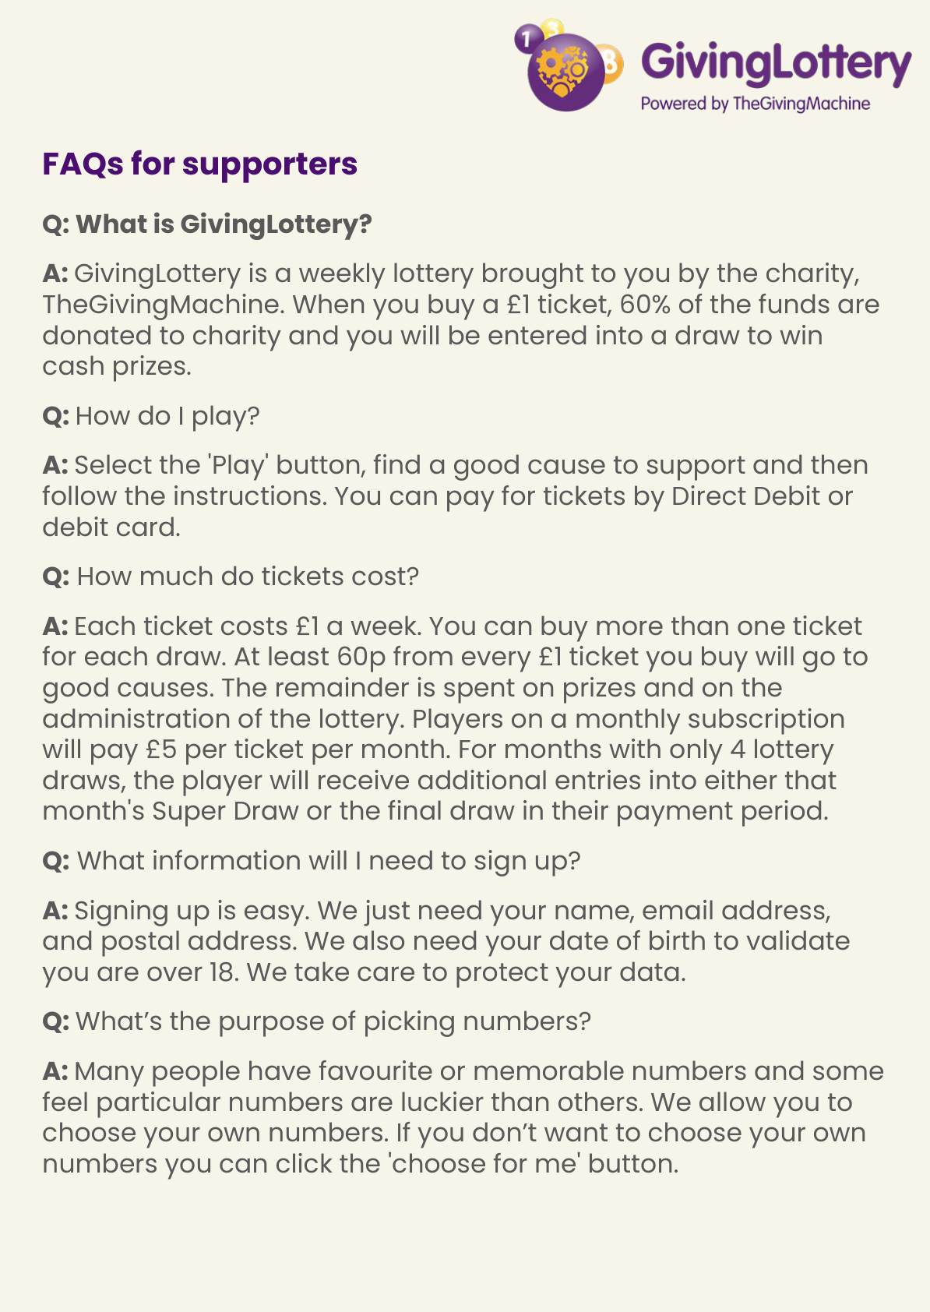
Supporter FAQs: the essentials
GivingLottery is a weekly lottery run by TheGivingMachine charity.
When you buy a £1 ticket, 60% of funds are donated to charities and you’re entered into a draw to win cash prizes.
How to play: select 'Play', choose a cause, and follow the steps.
Pay by Direct Debit or debit card.
Tickets cost £1/week; monthly subscription is £5 per ticket per month (with additional entries in some months). Sign-up info: name, email, postal address, and date of birth (18+ validation).
Picking numbers: choose your own or use 'choose for me'.
Odds: 1 in 50 chance to win a prize each week.
Winners are notified by email; winning numbers are published on website and Facebook.
Winnings are paid to the winner’s bank account or can be donated back to the good cause.
Support email: support@GivingLottery.org.uk
Notes:
FAQ details from page 12.

Slide 14
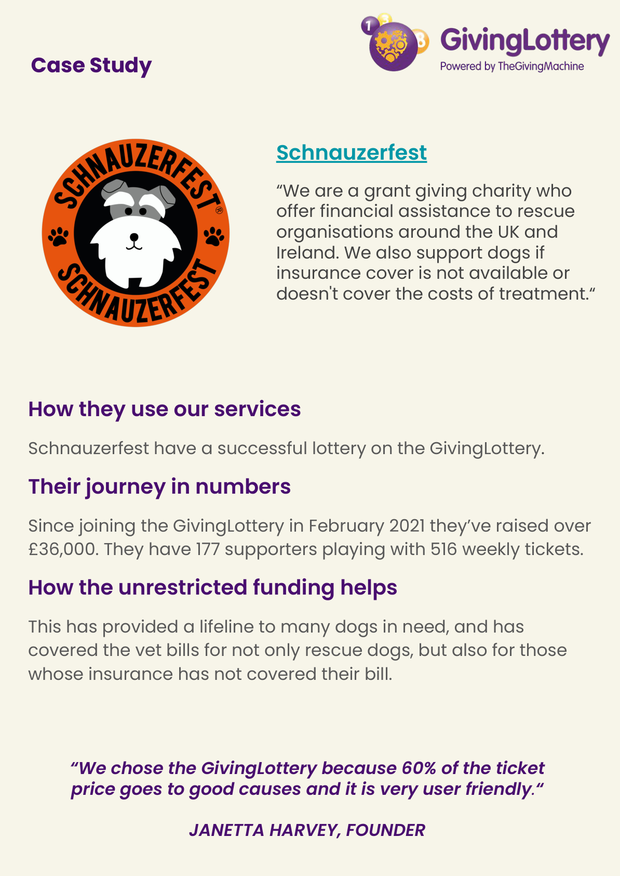
Case study: Schnauzerfest
Grant-giving charity supporting rescue organisations and dogs needing treatment funding.
Since joining (Feb 2021): raised over £36,000.
177 supporters playing with 516 weekly tickets.
Unrestricted funding has covered vet bills for rescue dogs and cases where insurance didn’t cover costs.
Notes:
Key figures from page 14.

Slide 15
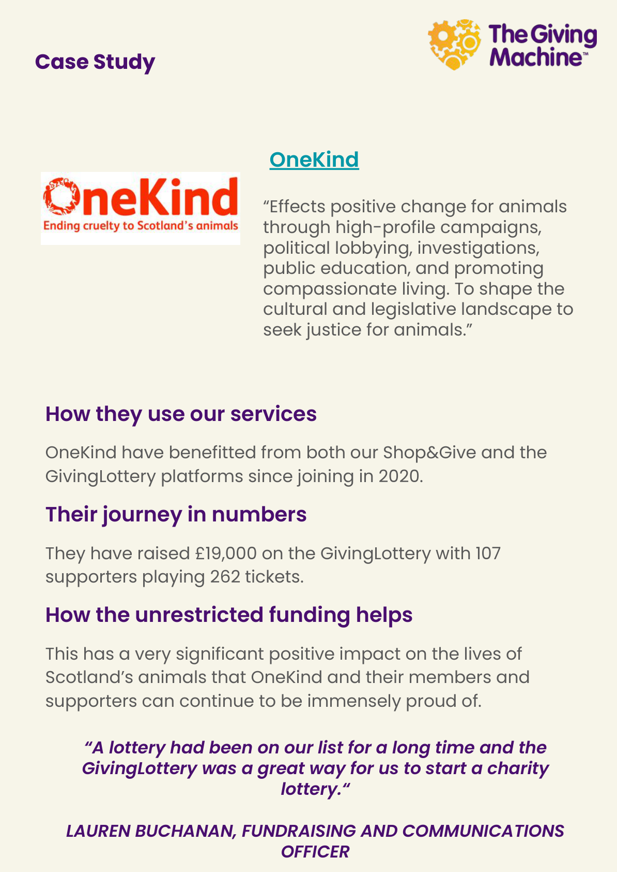
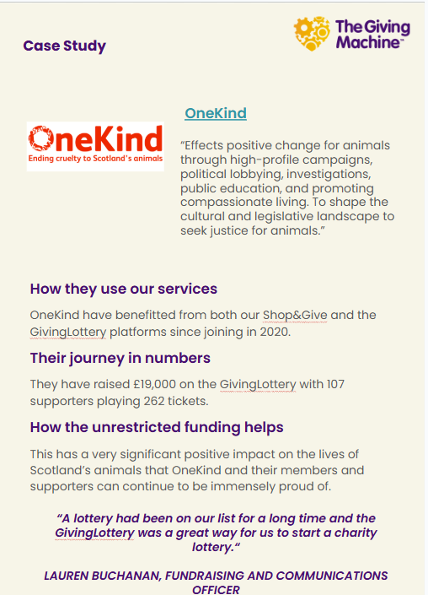
Case study: OneKind
Joined in October 2020.
Raised £19,000 on GivingLottery.
107 supporters playing 262 tickets.
Unrestricted funding supports positive change for Scotland’s animals through campaigns, lobbying, investigations and education.
Notes:
Based on page 15 (text-only in the pack).

Slide 16

Next steps & contact
Visit: thegivingmachine.co.uk/lottery
Email: info@thegivingmachine.co.uk
Use the creatives available in your lottery dashboard or our the above website page for promotion.
Notes:
Based on pages 5 and 16.

